Slide 2
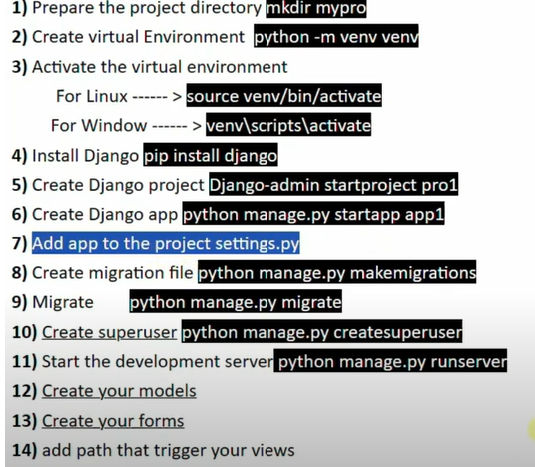

Slide 3
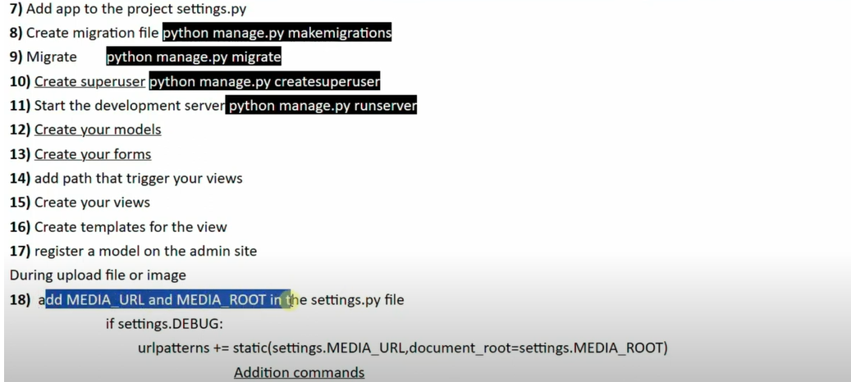

Slide 4
python manage.py sqlmigrate regional_info 0001 ORM-> create tables based on class model
BEGIN;
--
-- Create model RegionalInfo
--
CREATE TABLE "regional_info_regionalinfo" ("id" integer NOT NULL PRIMARY KEY AUTOINCREMENT, "region_number" smallint unsigned NOT NULL CHECK ("region_number" >= 0), "name" varchar(64) NOT NULL, "population_size" bigint unsigned NOT NULL CHECK ("population_size" >= 0), "area_in_square" real NOT NULL, "capital_city" varchar(100) NOT NULL, "flag" varchar(100) NOT NULL, "email_address" varchar(254) NOT NULL, "map" varchar(100) NOT NULL, "website" varchar(200) NOT NULL);
COMMIT;

Slide 5
python manage.py showmigrations
admin
[ ] 0001_initial
[ ] 0002_logentry_remove_auto_add
[ ] 0003_logentry_add_action_flag_choices
auth
[ ] 0001_initial
[ ] 0002_alter_permission_name_max_length
[ ] 0003_alter_user_email_max_length
[ ] 0004_alter_user_username_opts
[ ] 0005_alter_user_last_login_null
[ ] 0006_require_contenttypes_0002
[ ] 0007_alter_validators_add_error_messages
[ ] 0008_alter_user_username_max_length
[ ] 0009_alter_user_last_name_max_length
[ ] 0010_alter_group_name_max_length
[ ] 0011_update_proxy_permissions
[ ] 0012_alter_user_first_name_max_length
contenttypes
[ ] 0001_initial
[ ] 0002_remove_content_type_name
regional_info
[ ] 0001_initial
sessions
[ ] 0001_initial

Slide 6
Django MVC Pattern (actually MTV)
Django follows a slightly different architecture called MTV (Model–Template–View) — similar to MVC.

